Slide 1
The Importance of Healthcare
Quality
Dr. Md. Emdadul Haque

Slide 2
Why does Quality matter?
Increases the health status of individuals and the population
Poor quality can do harm
Social and economic benefits
Increases the efficiency of the health system

Slide 3


Slide 4

Oh dear!

Slide 5

Who should care!

Slide 6

Solve priority
Quality problems …

Slide 7

Our usual solution:
We need more RESOURCES!!!!

Slide 8

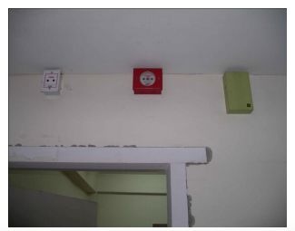
Quality Improvement
Although all improvement involves change,
not all changes are improvement.

Slide 9
Every SYSTEM achieves the RESULTS for which it was designed!

Slide 10

Deming Cycle

Slide 11
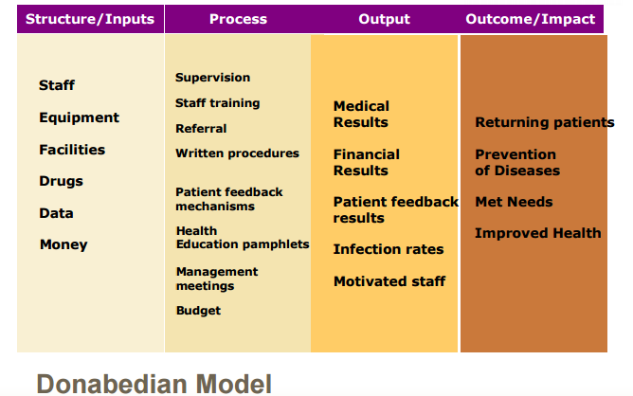

Slide 12
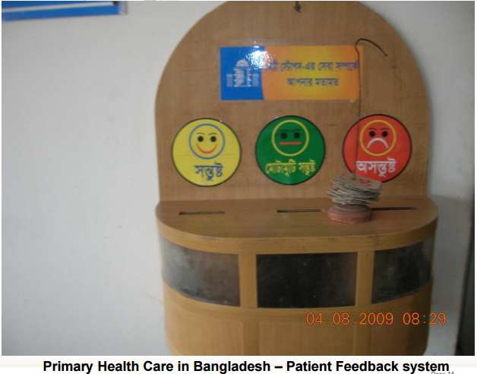

Slide 13





Changes in Surgery & Pediatric Word in Jhenaidah Sadar Hospital
Before
After
Before
After

Slide 14
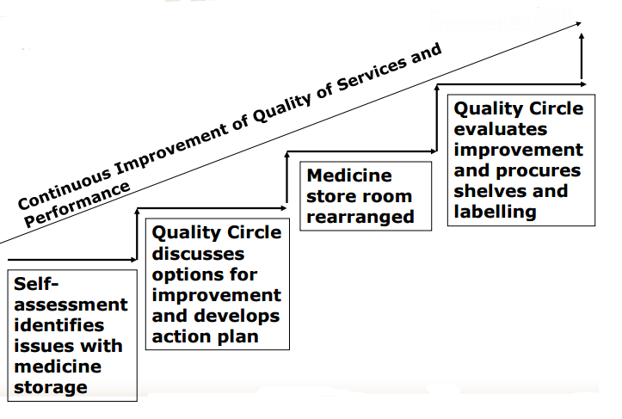
Quality Management is Continuous Improvement

Slide 15


Slide 16
People connect the links
“No quality management system works
unless people are empowered and
committed to take responsibility for quality
-as an ongoing process –
in the end, quality becomes part of people's behavior and attitudes”
Dr. Joseph Juran

Slide 17
The Paradigm Shift in Quality
from we know best what is good for you
    to customer orientation
2. from post-production evaluation to prevention and continuous improvement
3. from external focus on control through inspection to design and self assessment

Slide 18

Thank You

